Slide 1
Has it become a part of us?
DEPERESSION?
ISN`T IT VAGUE!!
Why is depression?

Slide 2
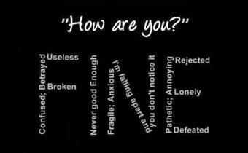
Vision:
Depression being an ideal cause for major medical conditions of people across the globe, and the vital reason that why these people didn`t get the treatment is that they never get to know that they are depressed until or unless they have words with a doctor or sometime people assume that they are depressed when they are not and in rest of the cases they are not known to their situation.
So, if there is something that is easy to access and better user interface which will decide that a person is diagnosed with depression or not with maximum efficiency, then we can help them out by letting them know about their condition.

Slide 3
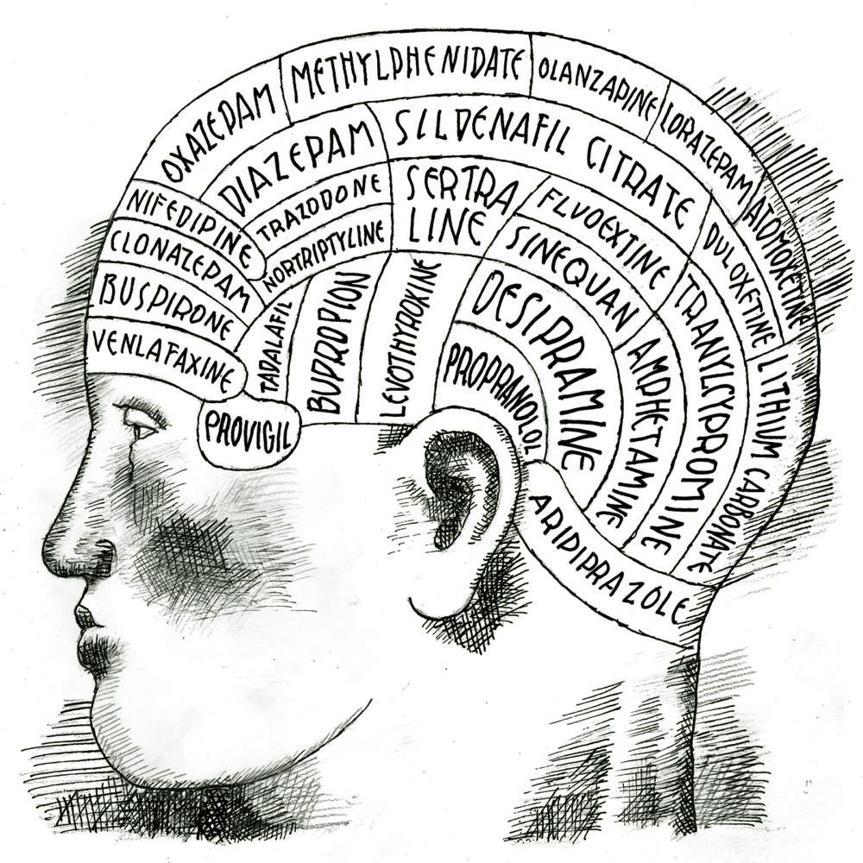
Solution that we came across:
We thought of an idea why not to have an app or website that will have a user friendly interaction in which each element describes something weather it is the colour or the concept, With this idea we continue for a prototype that will use some parameters that are the sure signs of depression in a person, So the prototype demands the parameter in percentage ranging method(PRM) ,these parameters are also verified by the world health organisation (WHO) .

Slide 4
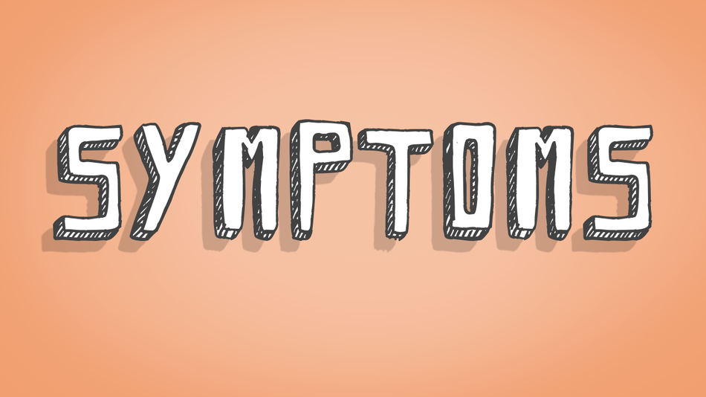
THE PARAMETERS:
1.Diminished Energy activities (for at least two weeks)
2.Anxiety
3.Feeling of Guilt or low self worth.
4.Easy irritability.
5.Emotional Outbreaks.
6.Apetite(over or low).
7.Suicidal thoughts.

Slide 5

ADVANTAGES:
1.Easy Knowledge of state of mental health.
2.Can save thousands of lifes by letting them known about their disorder.
3.No social pressure of ones health is faced while using this interface.
4.This app/websites is the treatment itself.
FUTURE SCOPE:
We can train the model for other MENTAL DISORDER and MEDICAL APPLICATIONS.

Slide 6

THANK YOU!

